Slide 1

TAKE ME TO CLASS
First approach
Darío Fernández Cortés
Pedro Javier Rodríguez Vílchez
Pablo Roas Domingo
Carlos Sánchez Páez

Slide 2
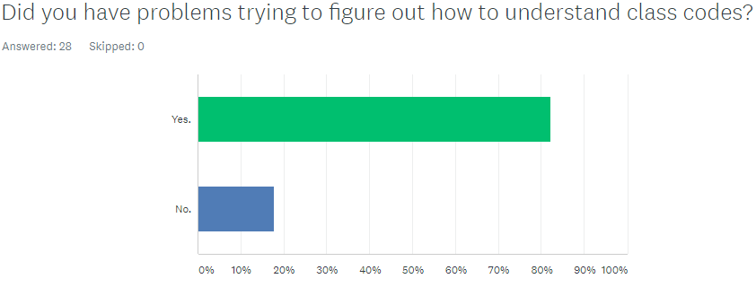
PROBLEM

Slide 3
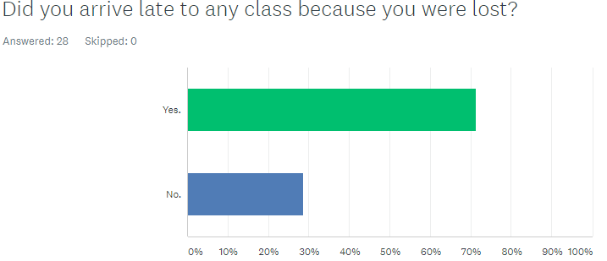

Slide 4
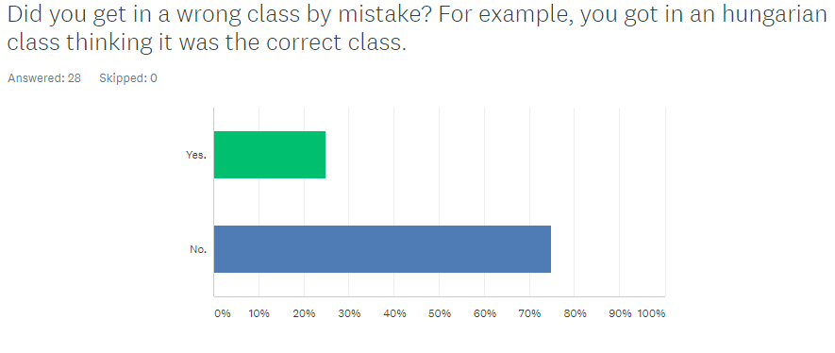

Slide 6
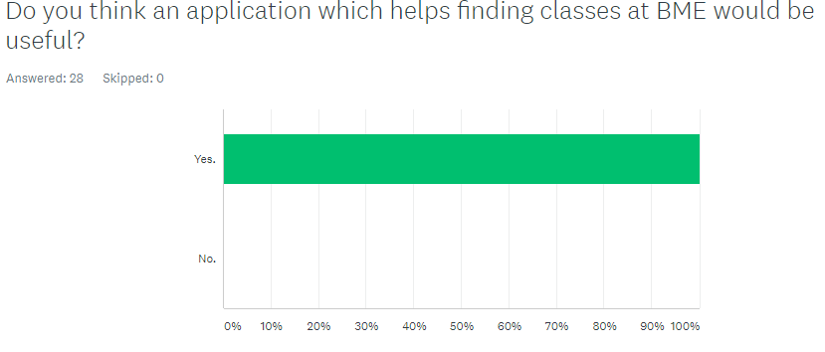

Slide 7

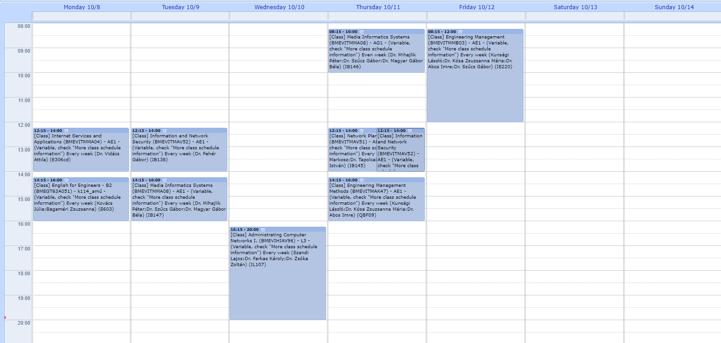
SOLUTION: TAKE ME TO CLASS

Slide 8
EXAMPLE OF USE
Internet Services & Applications
E306cd

Slide 9
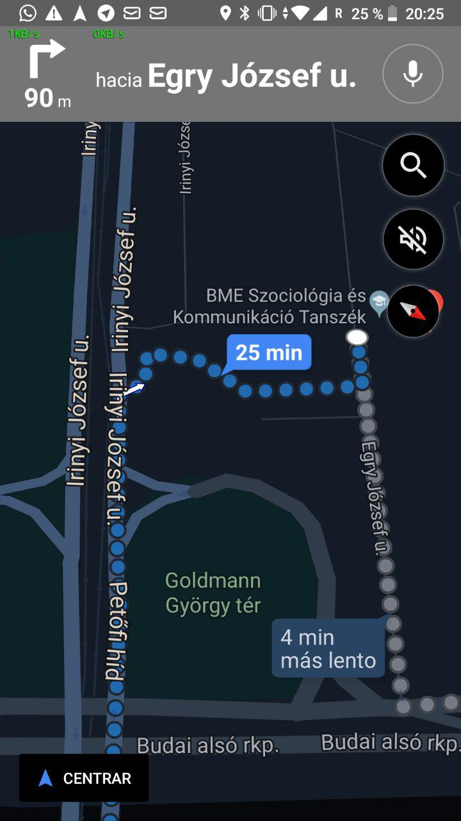
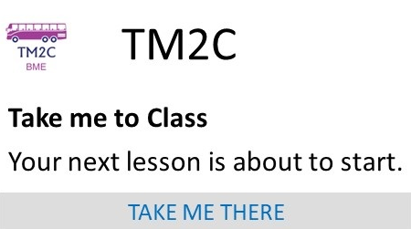
STEP 1

Slide 10

STEP 2
Go to the 3rd floor.
Find room 306cd.

Slide 11
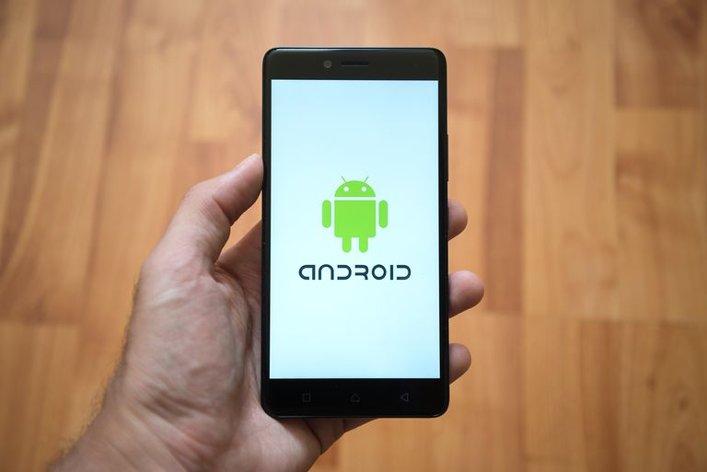


IMPLEMENTATION DETAILS

Slide 12
ANY QUESTIONS?
THANKS FOR YOUR ATTENTION.

